Slide 1
Sorting
Insertion sort
  Design approach:
  Sorts in place:
  Best case:
  Worst case:
Bubble Sort
  Design approach:
  Sorts in place:
  Running time:
incremental
Yes
Θ(n)
Θ(n²)
incremental
Yes
Θ(n²)

Slide 2
Sorting
Selection sort
  Design approach:
  Sorts in place:
  Running time:
Merge Sort
  Design approach:
  Sorts in place:
  Running time:
incremental
Yes
Θ(n²)
divide and conquer
No
Let’s see!!

Slide 3
Divide-and-Conquer
Divide the problem into a number of sub-problems
  Similar sub-problems of smaller size
Conquer the sub-problems
  Solve the sub-problems recursively
  Sub-problem size small enough ⇒ solve the problems in straightforward manner
Combine the solutions of the sub-problems
  Obtain the solution for the original problem

Slide 4
Merge Sort Approach
To sort an array A[p . . r]:
Divide
  Divide the n-element sequence to be sorted into two subsequences of n/2 elements each
Conquer
  Sort the subsequences recursively using merge sort
  When the size of the sequences is 1 there is nothing more to do
Combine
  Merge the two sorted subsequences

Slide 5
Merge Sort
p
q
r
1
2
3
4
5
6
7
8
Alg.: MERGE-SORT(A, p, r)
if p < r Check for base case
then q ← ⎣(p + r)/2⎦ Divide
MERGE-SORT(A, p, q) Conquer
MERGE-SORT(A, q + 1, r) Conquer
MERGE(A, p, q, r) Combine
Initial call: MERGE-SORT(A, 1, n)
5
2
4
7
1
3
2
6

Slide 6
Example – n Power of 2
Divide
1
2
3
4
5
6
7
8
5
2
4
7
1
3
2
6
q = 4
1
2
3
4
5
6
7
8
5
2
4
7
1
3
2
6
1
2
3
4
5
6
7
8
5
2
4
7
1
3
2
6
1
2
3
4
5
6
7
8
5
2
4
7
1
3
2
6

Slide 7
Example – n Power of 2
Conquer
and
Merge
1
2
3
4
5
6
7
8
1
2
2
3
4
5
6
7
1
2
3
4
5
6
7
8
2
4
5
7
1
2
3
6
1
2
3
4
5
6
7
8
2
5
4
7
1
3
2
6
1
2
3
4
5
6
7
8
5
2
4
7
1
3
2
6

Slide 8
Example – n Not a Power of 2
1
2
3
4
5
6
7
8
9
10
11
Divide
4
7
2
6
1
4
7
3
5
2
6
q = 6
1
2
3
4
5
6
7
8
9
10
11
q = 3
4
7
2
6
1
4
7
3
5
2
6
q = 9
1
2
3
4
5
6
7
8
9
10
11
4
7
2
6
1
4
7
3
5
2
6
1
2
3
4
5
6
7
8
9
10
11
4
7
2
6
1
4
7
3
5
2
6
1
2
4
5
7
8
4
7
6
1
7
3

Slide 9
Example – n Not a Power of 2
Conquer
and
Merge
1
2
3
4
5
6
7
8
9
10
11
1
2
2
3
4
4
5
6
6
7
7
1
2
3
4
5
6
7
8
9
10
11
1
2
4
4
6
7
2
3
5
6
7
1
2
3
4
5
6
7
8
9
10
11
2
4
7
1
4
6
3
5
7
2
6
1
2
3
4
5
6
7
8
9
10
11
4
7
2
1
6
4
3
7
5
2
6
1
2
4
5
7
8
4
7
6
1
7
3

Slide 10
Merging
p
q
r
1
2
3
4
5
6
7
8
2
4
5
7
1
2
3
6
Input: Array A and indices p, q, r such that p ≤ q < r
  Subarrays A[p . . q] and A[q + 1 . . r] are sorted
Output: One single sorted subarray A[p . . r]

Slide 11
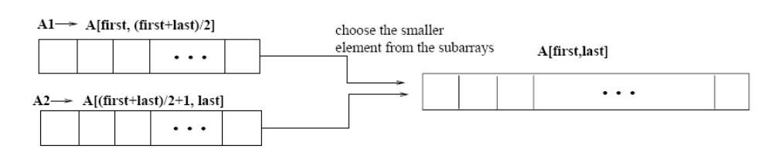
Merging
p
q
r
Idea for merging:
  Two piles of sorted cards
    Choose the smaller of the two top cards
    Remove it and place it in the output pile
  Repeat the process until one pile is empty
  Take the remaining input pile and place it face-down onto the output pile
1
2
3
4
5
6
7
8
2
4
5
7
1
2
3
6
A1← A[p, q]
A[p, r]
A2← A[q+1, r]

Slide 12
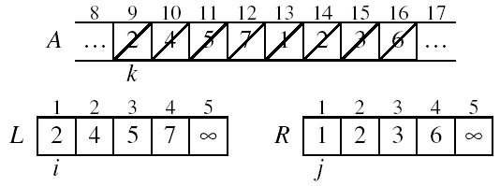
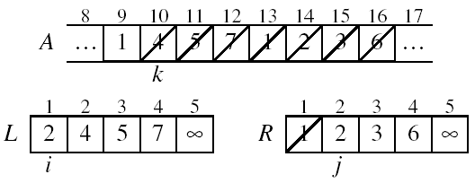
Example: MERGE(A, 9, 12, 16)
p
q
r

Slide 13
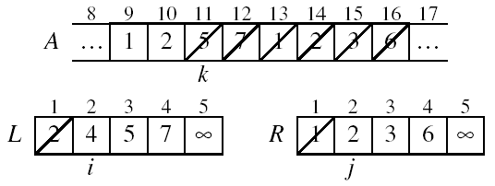
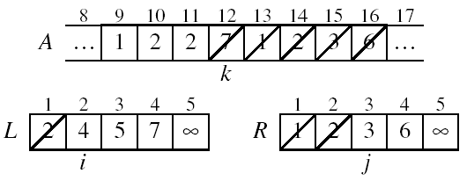
Example: MERGE(A, 9, 12, 16)

Slide 14
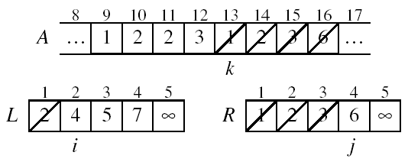
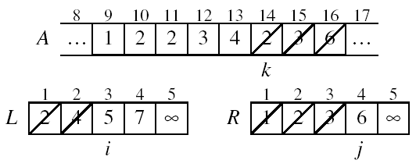
Example (cont.)

Slide 15
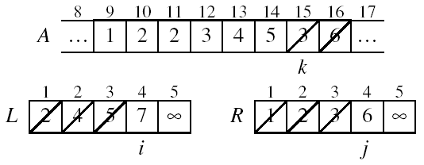
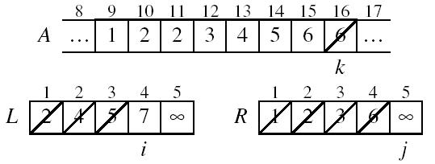
Example (cont.)

Slide 16
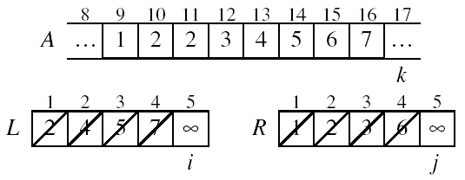
Example (cont.)
Done!

Slide 17
Merge - Pseudocode
p
q
r
Alg.: MERGE(A, p, q, r)
Compute n₁ and n₂
Copy the first n₁ elements into L[1 . . n₁ + 1] and the next n₂ elements into R[1 . . n₂ + 1]
L[n₁ + 1] ← ∞; R[n₂ + 1] ← ∞
i ← 1; j ← 1
for k ← p to r
do if L[ i ] ≤ R[ j ]
then A[k] ← L[ i ]
i ←i + 1
else A[k] ← R[ j ]
j ← j + 1
1
2
3
4
5
6
7
8
2
4
5
7
1
2
3
6
n₁
n₂
p
q
L
2
4
5
7
∞
q + 1
r
R
1
2
3
6
∞

Slide 18
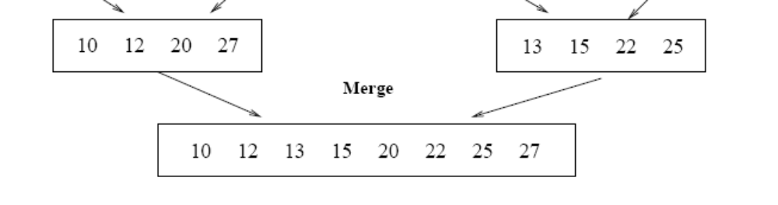
Running Time of Merge
(assume last for loop)
Initialization (copying into temporary arrays):
  Θ(n₁ + n₂) = Θ(n)
Adding the elements to the final array:
  - n iterations, each taking constant time ⇒ Θ(n)
Total time for Merge:
  Θ(n)

Slide 19
Analyzing Divide-and Conquer Algorithms
The recurrence is based on the three steps of the paradigm:
  T(n) – running time on a problem of size n
  Divide the problem into a subproblems, each of size n/b: takes D(n)
  Conquer (solve) the subproblems aT(n/b)
  Combine the solutions C(n)
Θ(1) if n ≤ c
T(n) = aT(n/b) + D(n) + C(n) otherwise

Slide 20
MERGE-SORT Running Time
Divide:
  compute q as the average of p and r: D(n) = Θ(1)
Conquer:
  recursively solve 2 subproblems, each of size n/2 ⇒ 2T (n/2)
Combine:
  MERGE on an n-element subarray takes Θ(n) time ⇒ C(n) = Θ(n)
Θ(1) if n =1
T(n) = 2T(n/2) + Θ(n) if n > 1

Slide 21
Solve the Recurrence
T(n) = c if n = 1
2T(n/2) + cn if n > 1
Use Master’s Theorem:
Compare n with f(n) = cn
Case 2: T(n) = Θ(nlgn)

Slide 22
Merge Sort - Discussion
Running time insensitive of the input
Advantages:
  Guaranteed to run in Θ(nlgn)
Disadvantage
  Requires extra space ≈N

Slide 23
Sorting Challenge 1
Problem: Sort a file of huge records with tiny keys
Example application: Reorganize your MP-3 files
Which method to use?
  merge sort, guaranteed to run in time ∼NlgN
  selection sort
  bubble sort
  a custom algorithm for huge records/tiny keys
  insertion sort

Slide 24
Sorting Files with Huge Records and Small Keys
Insertion sort or bubble sort?
  NO, too many exchanges
Selection sort?
  YES, it takes linear time for exchanges
Merge sort or custom method?
  Probably not: selection sort simpler, does less swaps

Slide 25
Sorting Challenge 2
Problem: Sort a huge randomly-ordered file of small records
Application: Process transaction record for a phone company
Which sorting method to use?
  Bubble sort
  Selection sort
  Mergesort guaranteed to run in time ∼NlgN
  Insertion sort

Slide 26
Sorting Huge, Randomly - Ordered Files
Selection sort?
  NO, always takes quadratic time
Bubble sort?
  NO, quadratic time for randomly-ordered keys
Insertion sort?
  NO, quadratic time for randomly-ordered keys
Mergesort?
  YES, it is designed for this problem

Slide 27
Sorting Challenge 3
Problem: sort a file that is already almost in order
Applications:
  Re-sort a huge database after a few changes
  Doublecheck that someone else sorted a file
Which sorting method to use?
  Mergesort, guaranteed to run in time ∼NlgN
  Selection sort
  Bubble sort
  A custom algorithm for almost in-order files
  Insertion sort

Slide 28
Sorting Files That are Almost in Order
Selection sort?
  NO, always takes quadratic time
Bubble sort?
  NO, bad for some definitions of “almost in order”
  Ex: B C D E F G H I J K L M N O P Q R S T U V W X Y Z A
Insertion sort?
  YES, takes linear time for most definitions of “almost in order”
Mergesort or custom method?
  Probably not: insertion sort simpler and faster

Slide 29
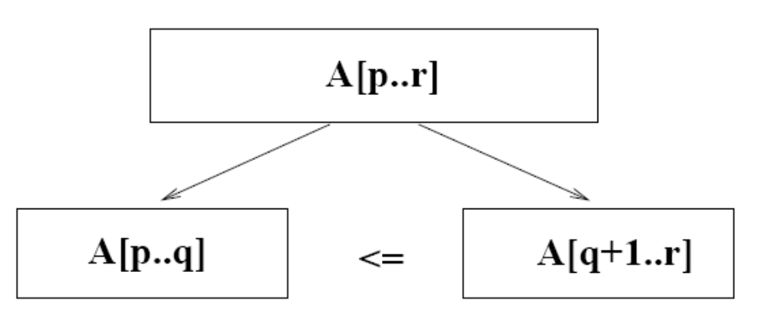
Quicksort
A[p…q]
≤
A[q+1…r]
Sort an array A[p…r]
Divide
  Partition the array A into 2 subarrays A[p..q] and A[q+1..r], such that each element of A[p..q] is smaller than or equal to each element in A[q+1..r]
  Need to find index q to partition the array

Slide 30
Quicksort
A[p…q]
≤
A[q+1…r]
Conquer
  Recursively sort A[p..q] and A[q+1..r] using Quicksort
Combine
  Trivial: the arrays are sorted in place
  No additional work is required to combine them
  The entire array is now sorted

Slide 31
QUICKSORT
Alg.: QUICKSORT(A, p, r)
if p < r
then q ← PARTITION(A, p, r)
QUICKSORT (A, p, q)
QUICKSORT (A, q+1, r)
Initially: p=1, r=n
Recurrence:
T(n) = T(q) + T(n – q) + f(n)
PARTITION())

Slide 32
Partitioning the Array
Choosing PARTITION()
  There are different ways to do this
  Each has its own advantages/disadvantages
Hoare partition (see prob. 7-1, page 159)
  Select a pivot element x around which to partition
  Grows two regions
A[p…i] ≤ x
x ≤ A[j…r]
A[p…i] ≤ x
x ≤ A[j…r]
i
j

Slide 33
Example
A[p…r]
pivot x=5
5
3
2
6
4
1
3
7
5
3
2
6
4
1
3
7
i
j
i
j
3
3
2
6
4
1
5
7
3
3
2
6
4
1
5
7
i
j
i
j
A[p…q]
A[q+1…r]
3
3
2
1
4
6
5
7
3
3
2
1
4
6
5
7
i
j
j
i

Slide 34
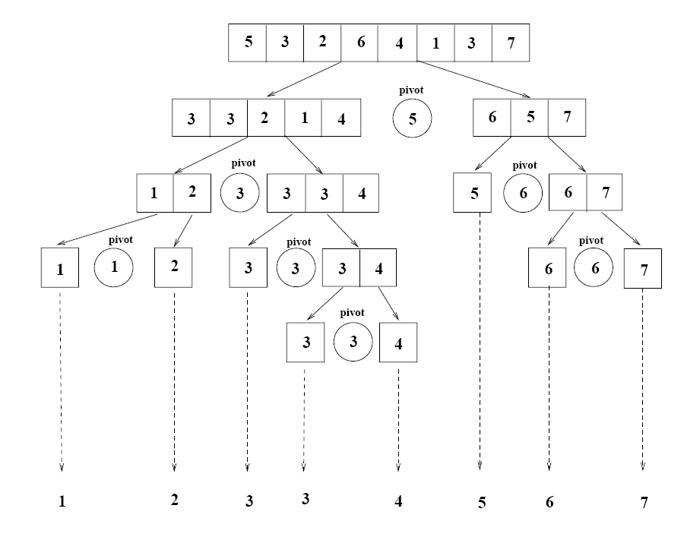
Example

Slide 35
Partitioning the Array
Alg. PARTITION (A, p, r)
x ← A[p]
i ← p – 1
j ← r + 1
while TRUE
do repeat j ← j – 1
until A[j] ≤ x
do repeat i ← i + 1
until A[i] ≥ x
if i < j
then exchange A[i] ↔ A[j]
else return j
p
r
A:
5
3
2
6
4
1
3
7
i
j
A[p…q]
≤
A[q+1…r]
A:
a_{p}
a_{r}
j=q
i
Each element is
visited once!
Running time: Θ(n)
n = r – p + 1

Slide 36
Recurrence
Alg.: QUICKSORT(A, p, r)
if p < r
then q ← PARTITION(A, p, r)
QUICKSORT (A, p, q)
QUICKSORT (A, q+1, r)
Initially: p=1, r=n
Recurrence:
T(n) = T(q) + T(n – q) + n

Slide 37
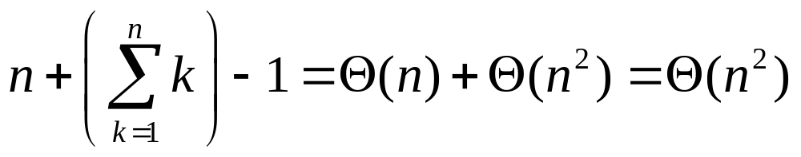
Worst Case Partitioning
Worst-case partitioning
  One region has one element and the other has n – 1 elements
  Maximally unbalanced
Recurrence: q=1
  T(n) = T(1) + T(n – 1) + n,
  T(1) = Θ(1)
  T(n) = T(n – 1) + n
  =
n
n
1
n - 1
n
1
n - 2
n - 1
n
1
n - 3
n - 2
1
2
3
1
1
2
Θ(n²)
When does the worst case happen?

Slide 38
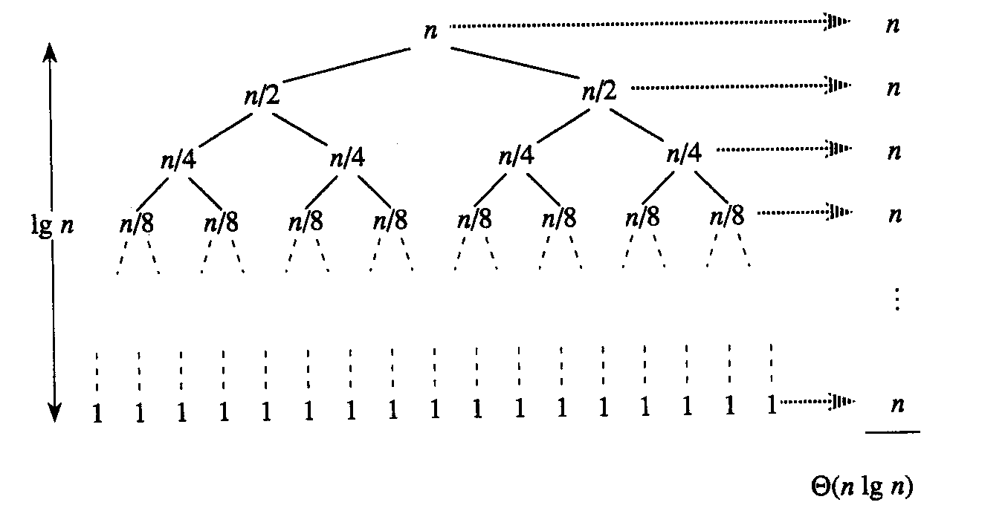
Best Case Partitioning
Best-case partitioning
  Partitioning produces two regions of size n/2
Recurrence: q=n/2
  T(n) = 2T(n/2) + Θ(n)
  T(n) = Θ(nlgn) (Master theorem)

Slide 39
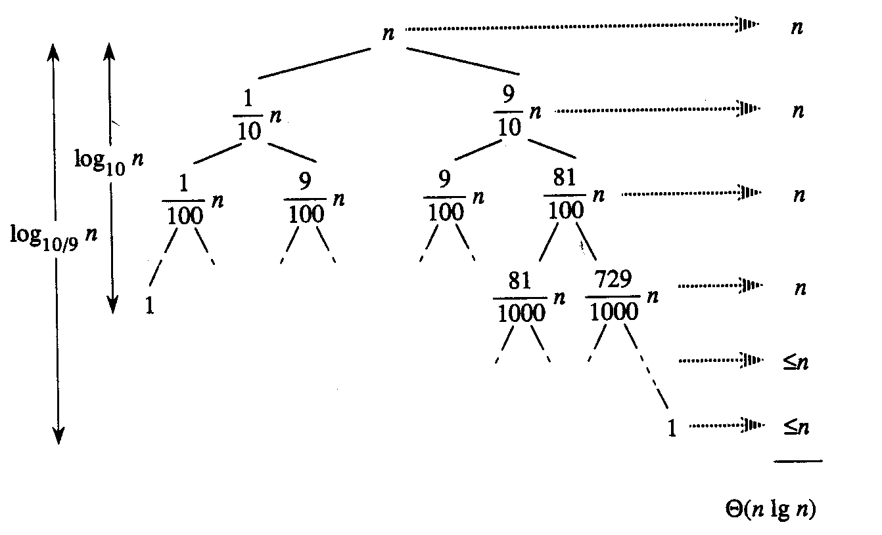
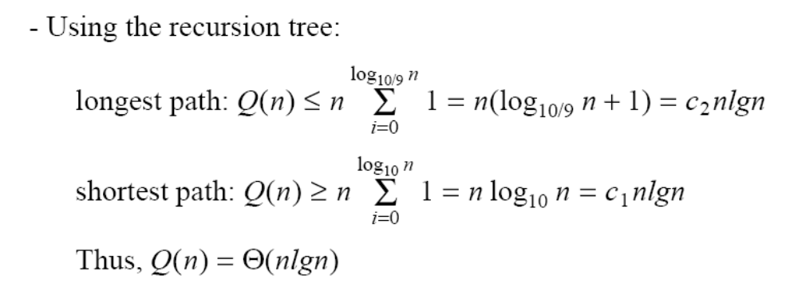
Case Between Worst and Best
9-to-1 proportional split
Q(n) = Q(9n/10) + Q(n/10) + n

Slide 40
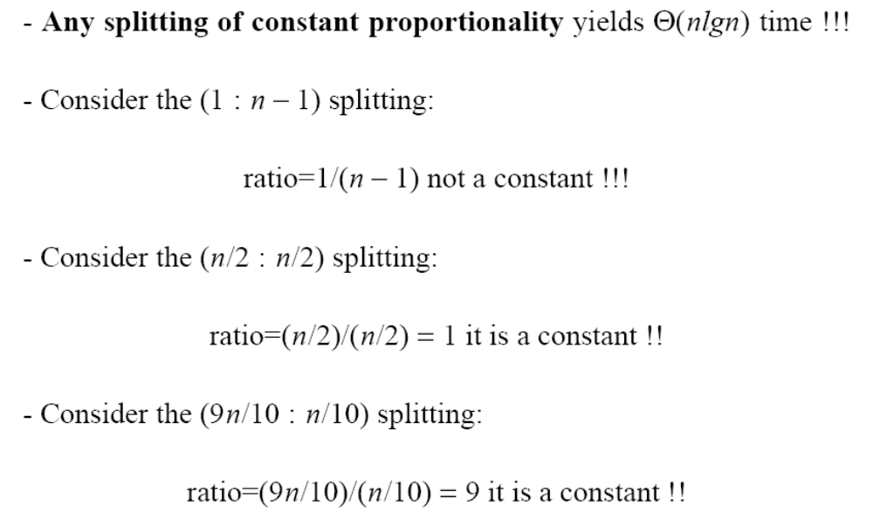
How does partition affect performance?

Slide 41
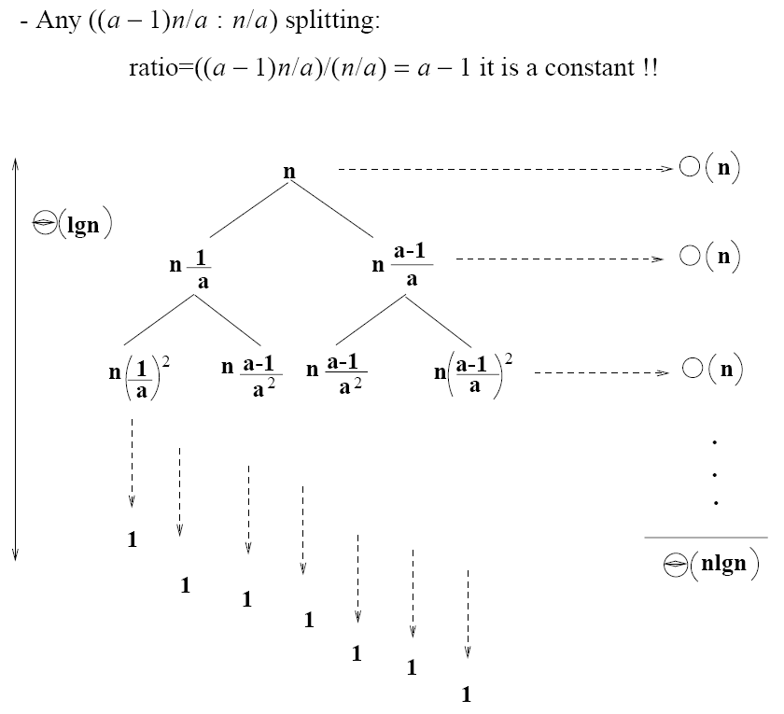
How does partition affect performance?

Slide 42
Performance of Quicksort
Average case
  All permutations of the input numbers are equally likely
  On a random input array, we will have a mix of well balanced and unbalanced splits
  Good and bad splits are randomly distributed across throughout the tree
partitioning cost:
n = Θ(n)
n
combined partitioning cost:
2n-1 = Θ(n)
n
1
n - 1
(n – 1)/2 + 1
(n – 1)/2
(n – 1)/2
(n – 1)/2
Alternate of a good
and a bad split
Nearly well
balanced split
Running time of Quicksort when levels alternate between good and bad splits is O(nlgn)

Slide 43
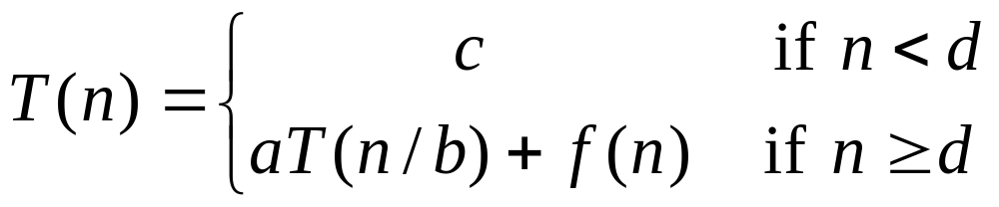
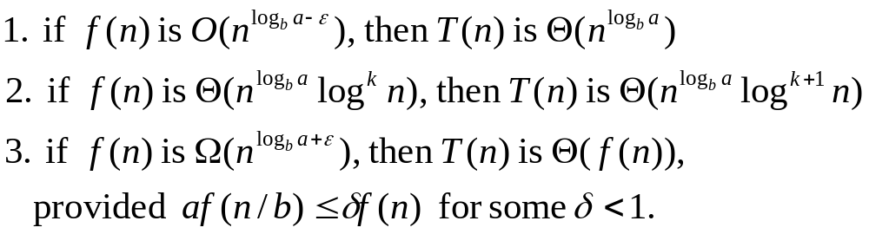
Master Method
Many divide-and-conquer recurrence equations have the form:
The Master Theorem:
Divide-and-Conquer

Slide 44
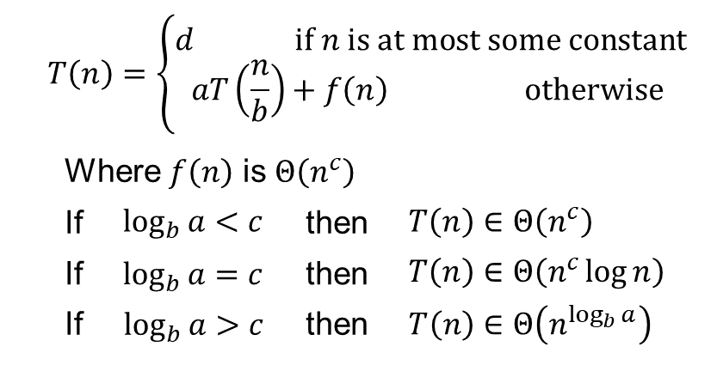
Master Method (Simplified)
Let T(n) be a monotonically increasing function that satisfies
Ref Book: Sridhar (oxford Publication )

Slide 45

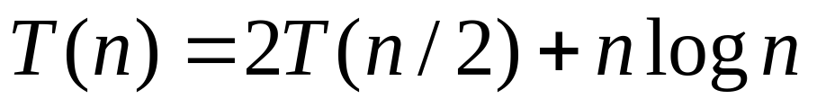
Master Method, Example 2
The form:
:
Example:
Solution: log_{b}a=1, so case 2 says T(n) is O(n log² n).
Divide-and-Conquer

Slide 46


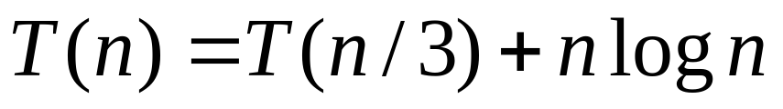
Master Method, Example 3
The form:
The Master Theorem:
Example:
Solution: log_{b}a=0, so case 3 says T(n) is O(n log n).
Divide-and-Conquer

Slide 47

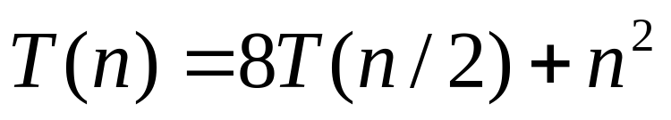
Master Method, Example 4
The form:
The Master Theorem:
Example:
Solution: log_{b}a=3, so case 1 says T(n) is O(n³).
Divide-and-Conquer

Slide 48
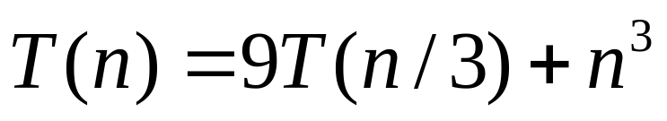
Master Method, Example 5
The form:
The Master Theorem:
Example:
Solution: log_{b}a=2, so case 3 says T(n) is O(n³).
Divide-and-Conquer

Slide 49
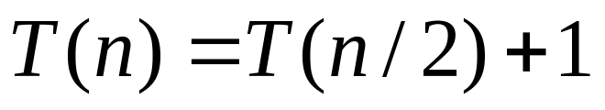
Master Method, Example 6
The form:
The Master Theorem:
Example:
(binary search)
Solution: log_{b}a=0, so case 2 says T(n) is O(log n).
Divide-and-Conquer

Slide 50
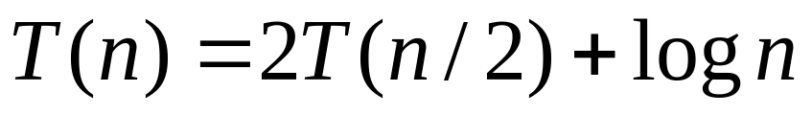
Master Method, Example 7
The form:
The Master Theorem:
Example:
(heap construction)
Solution: log_{b}a=1, so case 1 says T(n) is O(n).
Divide-and-Conquer

Slide 51
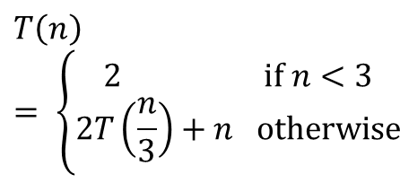
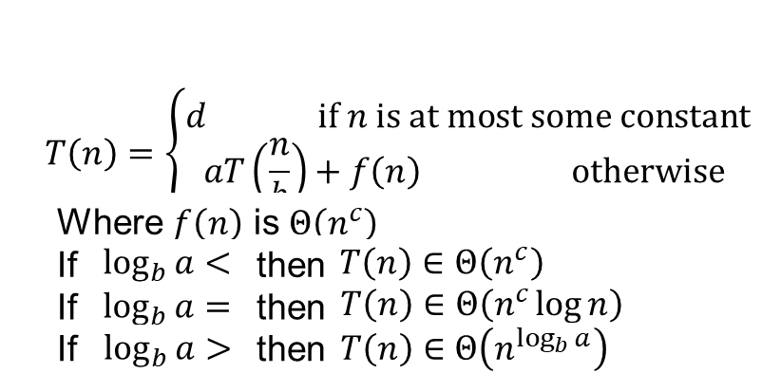
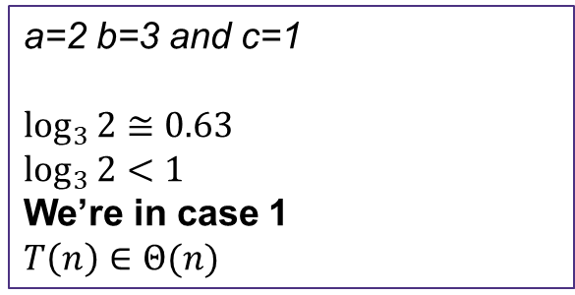

Recurrence to Big-Θ
It’s still really hard to tell what the Big-Θ is just by looking at it.
But fancy mathematicians have a formula for us to use!

Slide 52
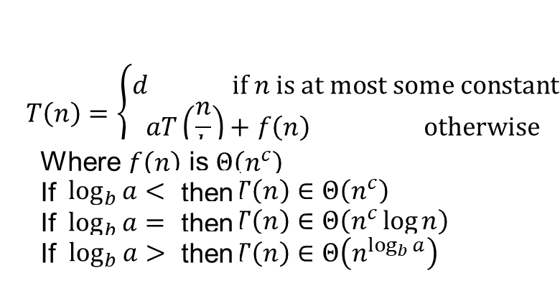



Aside Understanding the Master Theorem
The case
  Recursive case does a lot of non recursive work in comparison to how quickly it divides the input size
  Most work happens in beginning of call stack
  Non recursive work in recursive case dominates growth, n^{c} term
The case
  Recursive case evenly splits work between non recursive work and passing along inputs to subsequent recursive calls
  Work is distributed across call stack
The case
  Recursive case breaks inputs apart quickly and doesn’t do much non recursive work
  Most work happens near bottom of call stack
a measures how many recursive calls are triggered by each method instance
b measures the rate of change for input
c measures the dominating term of the non recursive work within the recursive method
d measures the work done in the base case

Slide 53
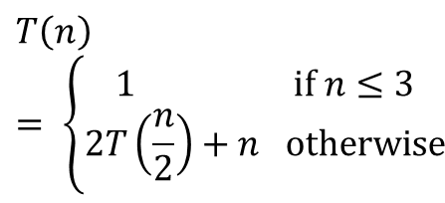

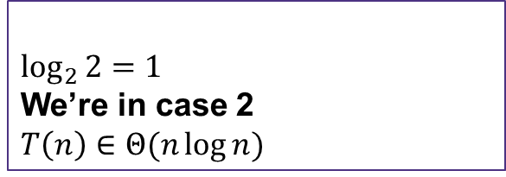
Merge Sort Recurrence to Big-Θ
a=2
b=2
and c=1

